Slide 1
Membership

Slide 2
But First …. Let’s Review ……
Mission To advance gender equity for women and girls through research, education, and advocacy.
Vision Equity for all.
Values Nonpartisan. Fact-based.
Integrity. Inclusion.
Notes:
Slides 1-2 lay the groundwork – remind members of AAUW’s mission, vision, and values and what the current requirement for membership includes.
The push to open membership is to align our mission, vision, and values with our restrictive and non-inclusive membership requirement.
We cannot be champions for equity while treating people unequally.

Slide 3
AAUW’s Educational Requirement
Eligible:
Women, men, nonbinary people with an Associate Degree or higher from a college or university
Ineligible:
Persons who began but did not complete their studies
Working professionals who do not have a college degree
Lilly Ledbetter, a national leading voice in the fight for pay equity

Slide 4
Our Historic Roots in 19th Century America AAUW provided opportunity to use education to support women and be supportive peers Remember our 1st research report: “Proved education didn’t cause women’s sterility”
AAUW Today: Areas of Focus
Education & Training: Addressing barriers & biases hindering advancement of women
Economic Security: Ensuring livelihoods for women
Leadership: Closing the gender gap
Notes:
In AAUW’s early work, educated women were pariahs and were treated with suspicion by academic peers (who were men) as well as other women.
AAUW filled a needed niche.
Women now earn more degrees than men at all levels – associate through advanced degrees.
Times have changed and AAUW must change with them.

Slide 5
Personal Stories and Thoughts
Marie Bonilla
Denise Burian
Peggy Cabaniss
Notes:
Open membership will help AAUW live its mission

Slide 6
Promotes our Values of Diversity, Equity & Inclusion
I am Voting YES on Removing the College Requirement?
We need ALL of us in this fight toward equity for women and girls!
* Men can join.
* Community College graduates can join.
* Time to allow ALL Women, regardless of education level, to join.
* Because I believe in Diversity, Equity and Inclusion.
* Demonstrates to other organizations and businesses that we,
and AAUW, are living our values and supports our mission of
Equity for all women.
Notes:
Open membership will help AAUW live its mission

Slide 7
All of US
We need all of us in this fight for Equity for Women and Girls
Supports our mission to advance equity. This limitation is counterproductive to recruiting a more diverse and younger membership. (It is discriminatory and looks elitist)
Greater diversity will strengthen our ability to advance equity, and supports our role model image and reputation.
Certainly ALL women can experience gender inequity whether she has a college degree or not (AND probably experiences it even more than college educated women).
Women without degrees can be strong advocates with us in advancing our mission.
Times have changed. Women can now join 99% of all organizations. And we need everyone to join us to work towards equity within those organizations.
FINANCIAL - Because we are seen as discriminatory, we are passed over for many grants and other financial resources that we need to accomplish our mission of advancing equity for all women.

Slide 8
FY 2021 Revenue Budget

Slide 9
FY 2021 Contribution Budget

Slide 10
Open Membership and Inclusion
Diversity
AAUW needs to include members with diverse backgrounds and perspectives to meet our mission and address society’s needs today.
AAUW Vision: Equity for All
Our membership practices should align with our vision and goals.
Alternate Pathways to Education
On-the-job training
Career Technical Education
Life experience
Notes:
Open membership will help AAUW live its mission

Slide 11
VOTE!
VOTING: Opens Apr. 7th Closes May 19th
Members received e-mail ballot from Shannon Wolfe, AAUW on Apr. 7th titled “Vote now to shape AAUW’s future”
The email came from: memberinfo@email.aauw.org
Non email members, or if you unsubscribed to receiving emails, will get a paper ballot in the mail. Return paper ballot postmarked by 4/30/21.
If you can’t find the 4/7 email, you can request a new email with the link and pin # to vote by sending an email to connect@aauw.org. Try to include your name, Branch and member # (call Marie B or Peggy C if you don’t know your member #)
MAKE YOUR VOICE HEARD

Slide 12
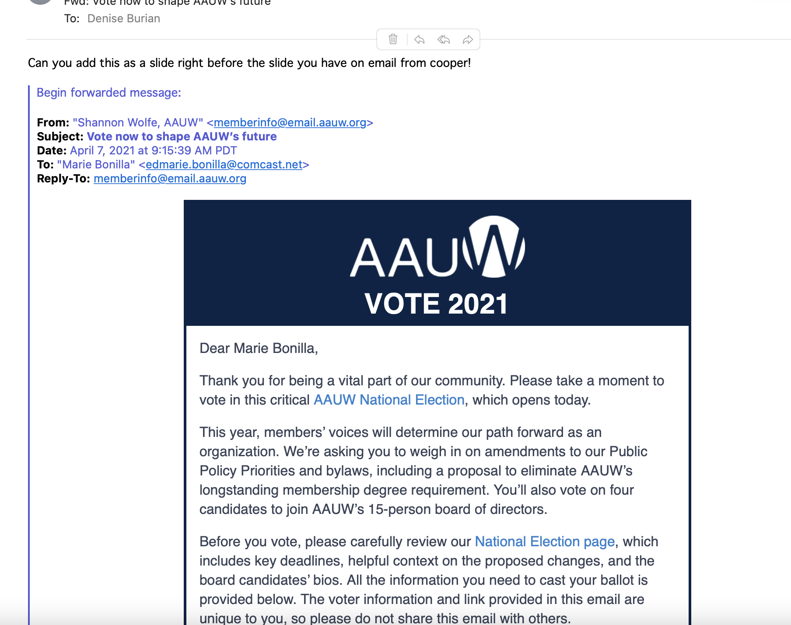

Slide 13
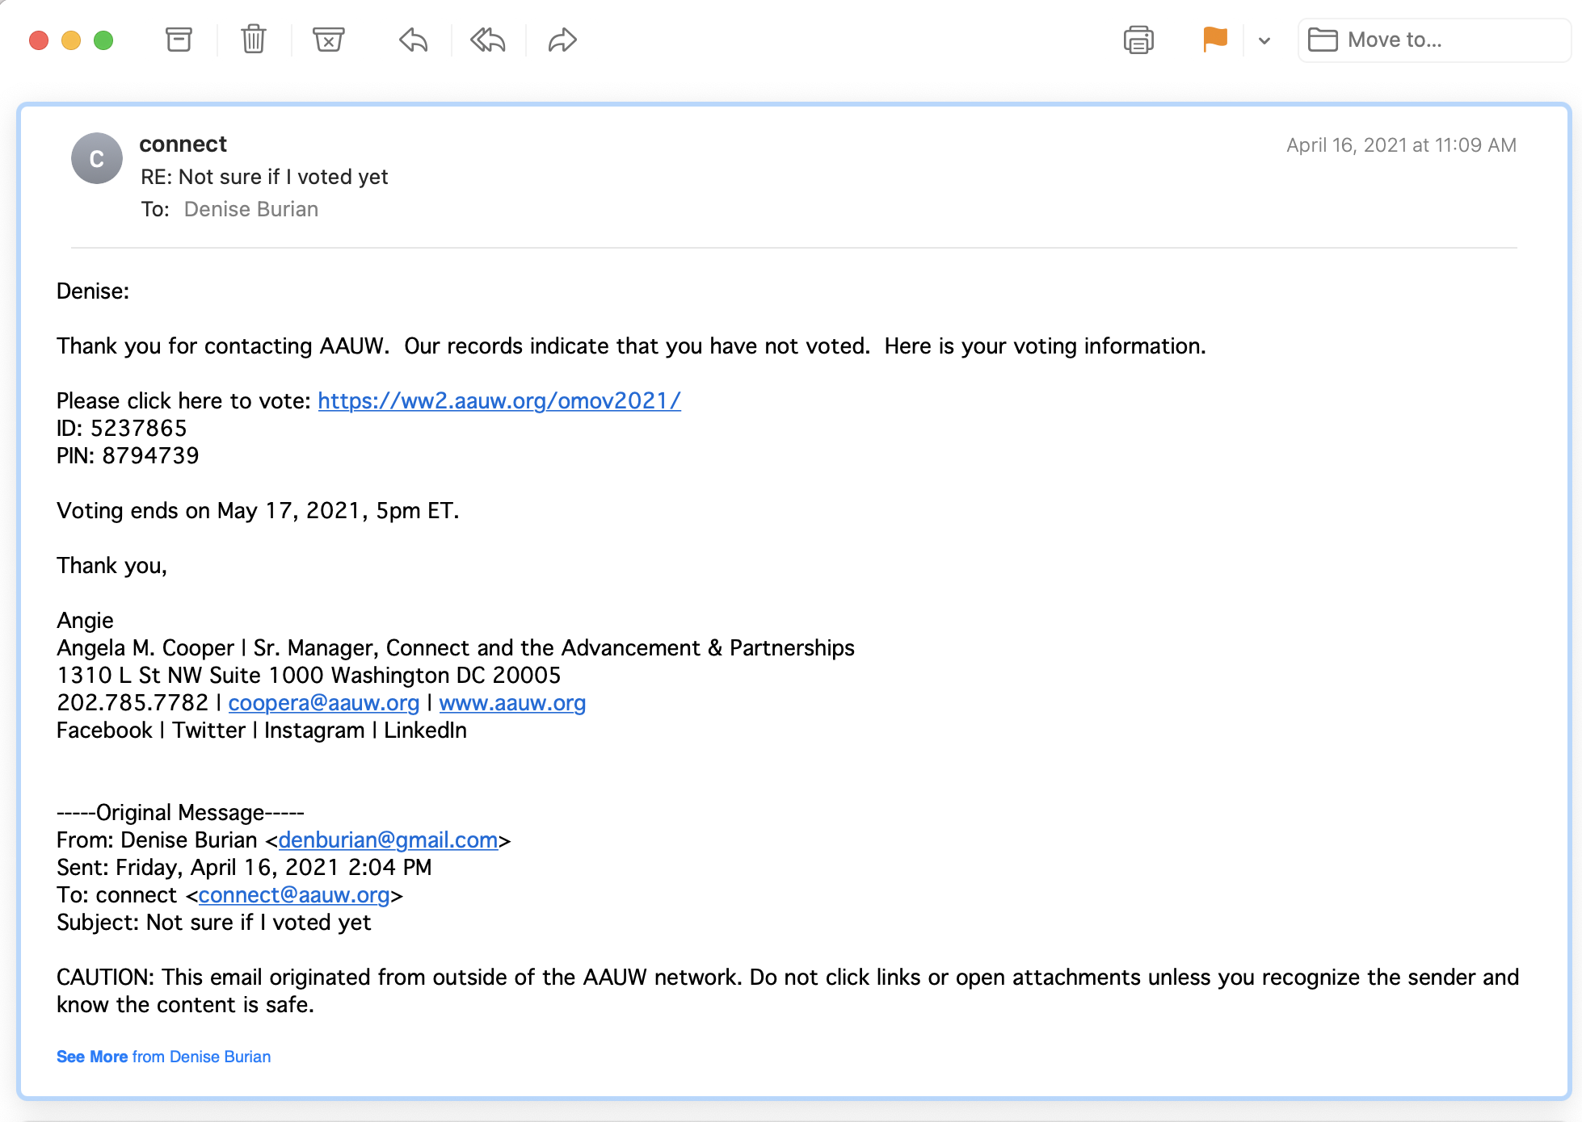

Slide 14
VOTE!
VOTING:
Email around April 7th
AAUW National vote Closes May 19th
If you have paper ballot - postmark by 4/30
Members received e-mail ballot from Shannon Wolfe, AAUW on Apr. 7th titled “Vote now to shape AAUW’s future”
The email came from: memberinfo@email.aauw.org
If you can’t find the 4/7 email, you can request a new email with the link and pin # to vote by sending an email to connect@aauw.org.
AAUW CA also has a vote in progress. Please don’t confuse them. Vote in both the AAUW National election and the AAUW CA one.
MAKE YOUR VOICE HEARD

